Slide 1
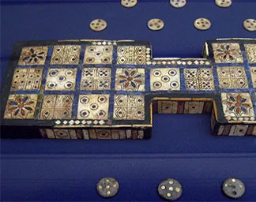
Paper Prototype: The Royal Game of Ur
University of South Carolina
ISAT/CSCI B145
Final Project
Ian Bickford

Slide 2
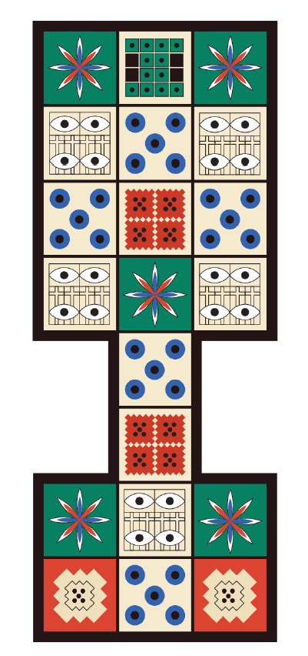


Game Route: JFR Masters Route
= Player 1’s Route
= Player 2’s Route
Once a piece has entered the center war lane, using this route, that piece is no longer safe. The ideology behind this being the route that I chose, is that much like in real war, once you are on the battlefield, you are not safe until you are off the battlefield.
I would also like to note that the middle rosette on my board is NOT a safe space, for the same reason listed above.

Slide 3
Royal Game of Ur Rules
Merge of Irving Finkel vs Tom Scott and original Irving Finkel Rules, with modifications.
JFR Masters Route used, reference included route map for details.
A player may choose any piece they wish to move as long as the result of that move lands the piece either on a vacant space, or within a war engagement with an opposing player’s piece. (This also applies to starting a piece on the board)
If a player rolls a number that lands their piece on a rosette, that player gets to roll again and can choose to either move that same piece again or move a different piece.
An exact dice throw is required to get a piece off the board or to start a war engagement with another player. (i.e. If your piece is 3 spaces away from being off the board, you must roll a 3 to travel the 2 spaces to the end of the board and the 1 space off the board. Likewise, if a player you want to attack is 3 spaces away, you must roll a 3 to engage in war with them.)
Seven pieces are used for both players to control.
You win the game when all 7 of your pieces make it off the board. Additionally, there is another way to win using the 1st modification found below.
Modification 1: Each piece has an assigned tier level associated with them. These tiers range from 1-3, and there will be 3 tier I pieces, 3 tier II pieces, and 1 tier III piece for each player. These tiers represent classes in the ancient city of Ur, with the lone tier III piece on each side representing “The King”. If “The King” of either side is lost, that player that lost their “King” automatically loses the game.
Modification 2: A player is said to be engaged in war when a piece lands on a space that is occupied by an opposing player’s piece. However, that player does not automatically capture that piece. Instead, you “engage in war”, where the 2 pieces will have a chance to win the fight. This is done by using the previously mentioned tier system. To engage in war, each piece takes turns rolling a die. The tier of the piece determines the number of dice rolls that the player gets to roll. The highest of all dice rolls is used for the outcome of the battle, favoring the defending player in the event of a tie (the player that occupied the space first.)
Dice Rolls Mapping for Movement: 1-1, 2-2, 3-3, 4-4, 5-0, 6- (Roll again as if you didn’t roll a 6, this is to ensure each distance of movement has an equal chance to be rolled.)

Slide 4
Physical Gameboard Picture

Slide 5
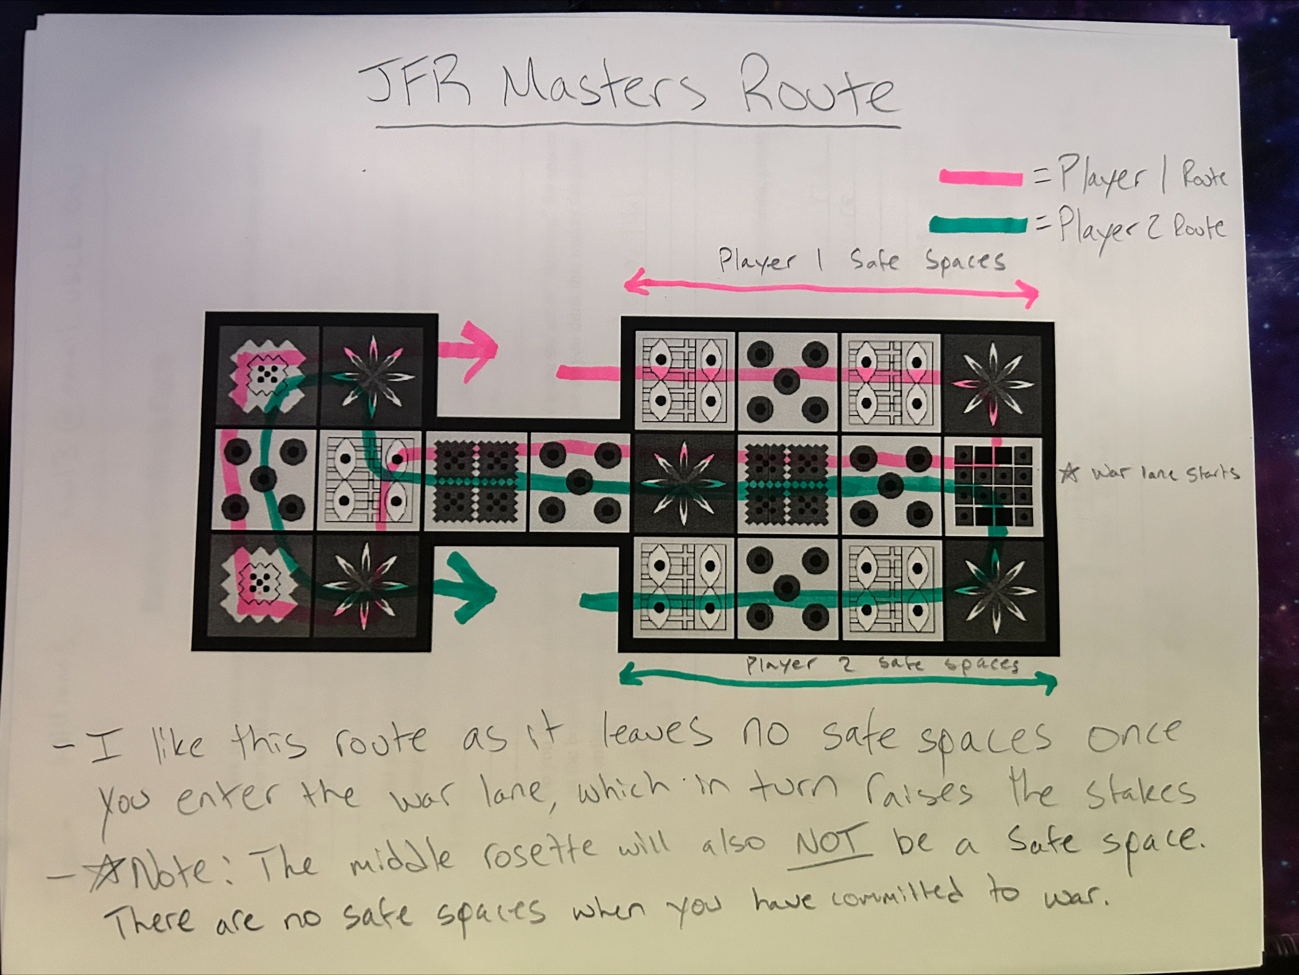
Physical Paper Route

Slide 6
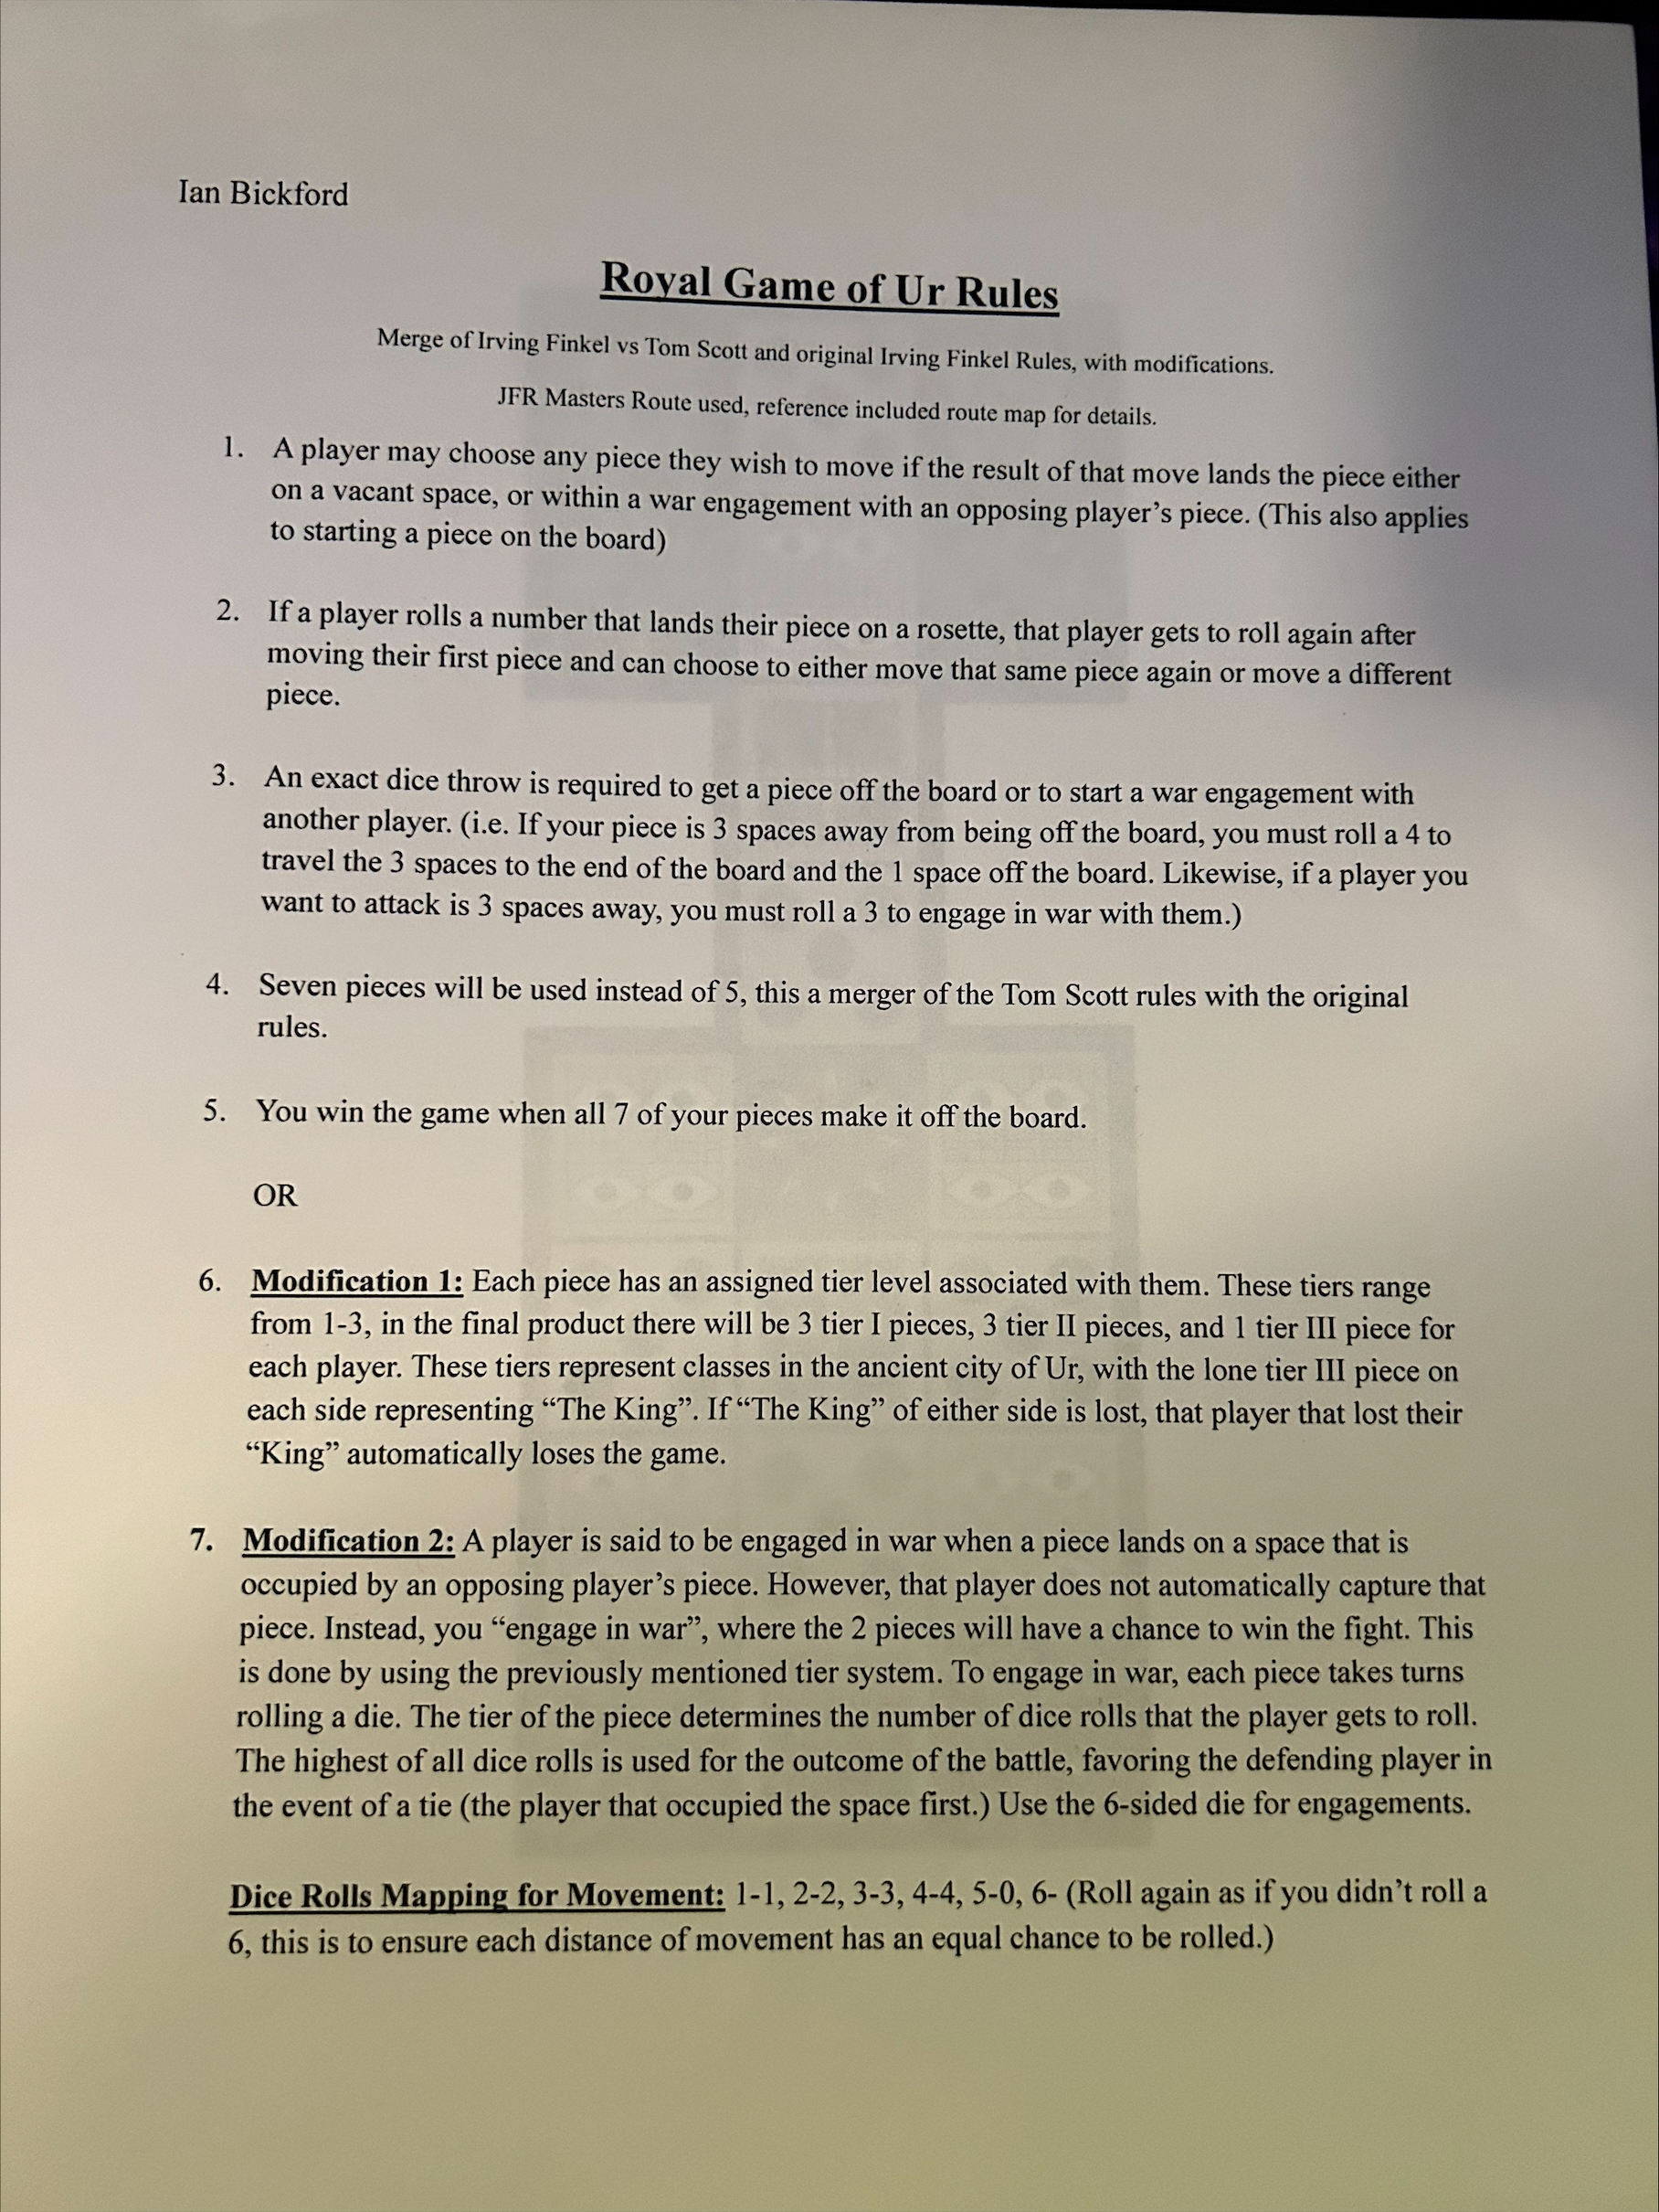
Physical Paper Rules

Slide 7
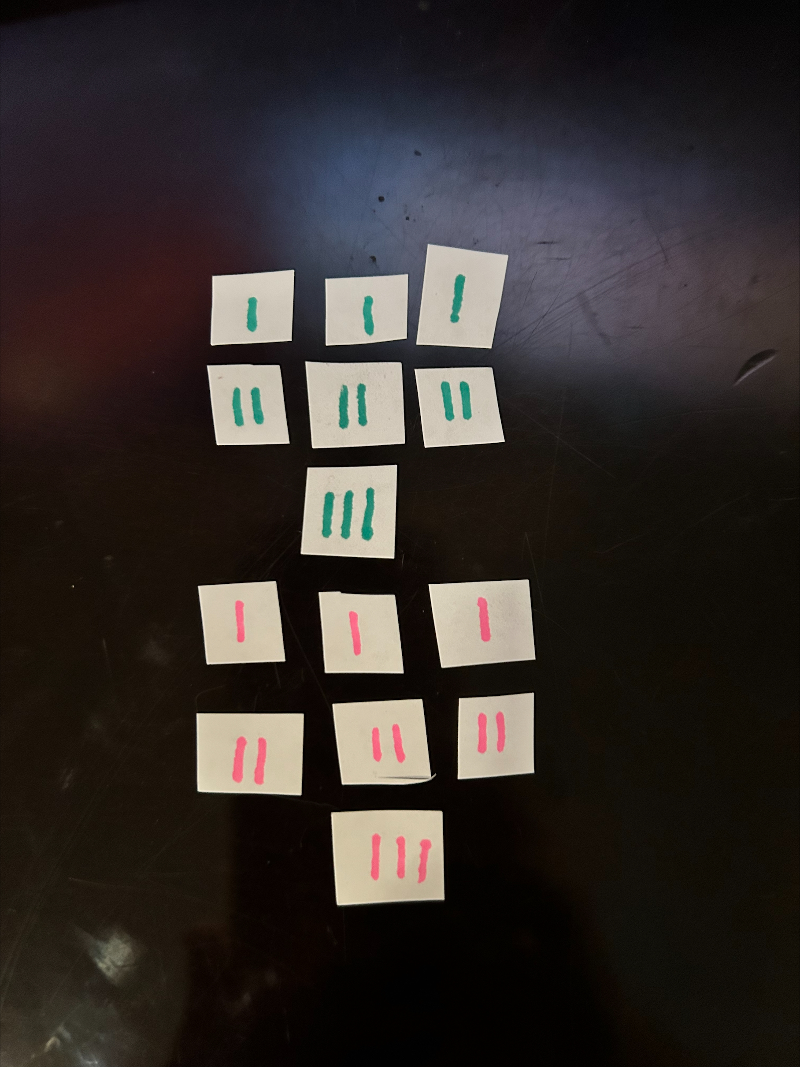
Physical Paper Player Pieces

Slide 8
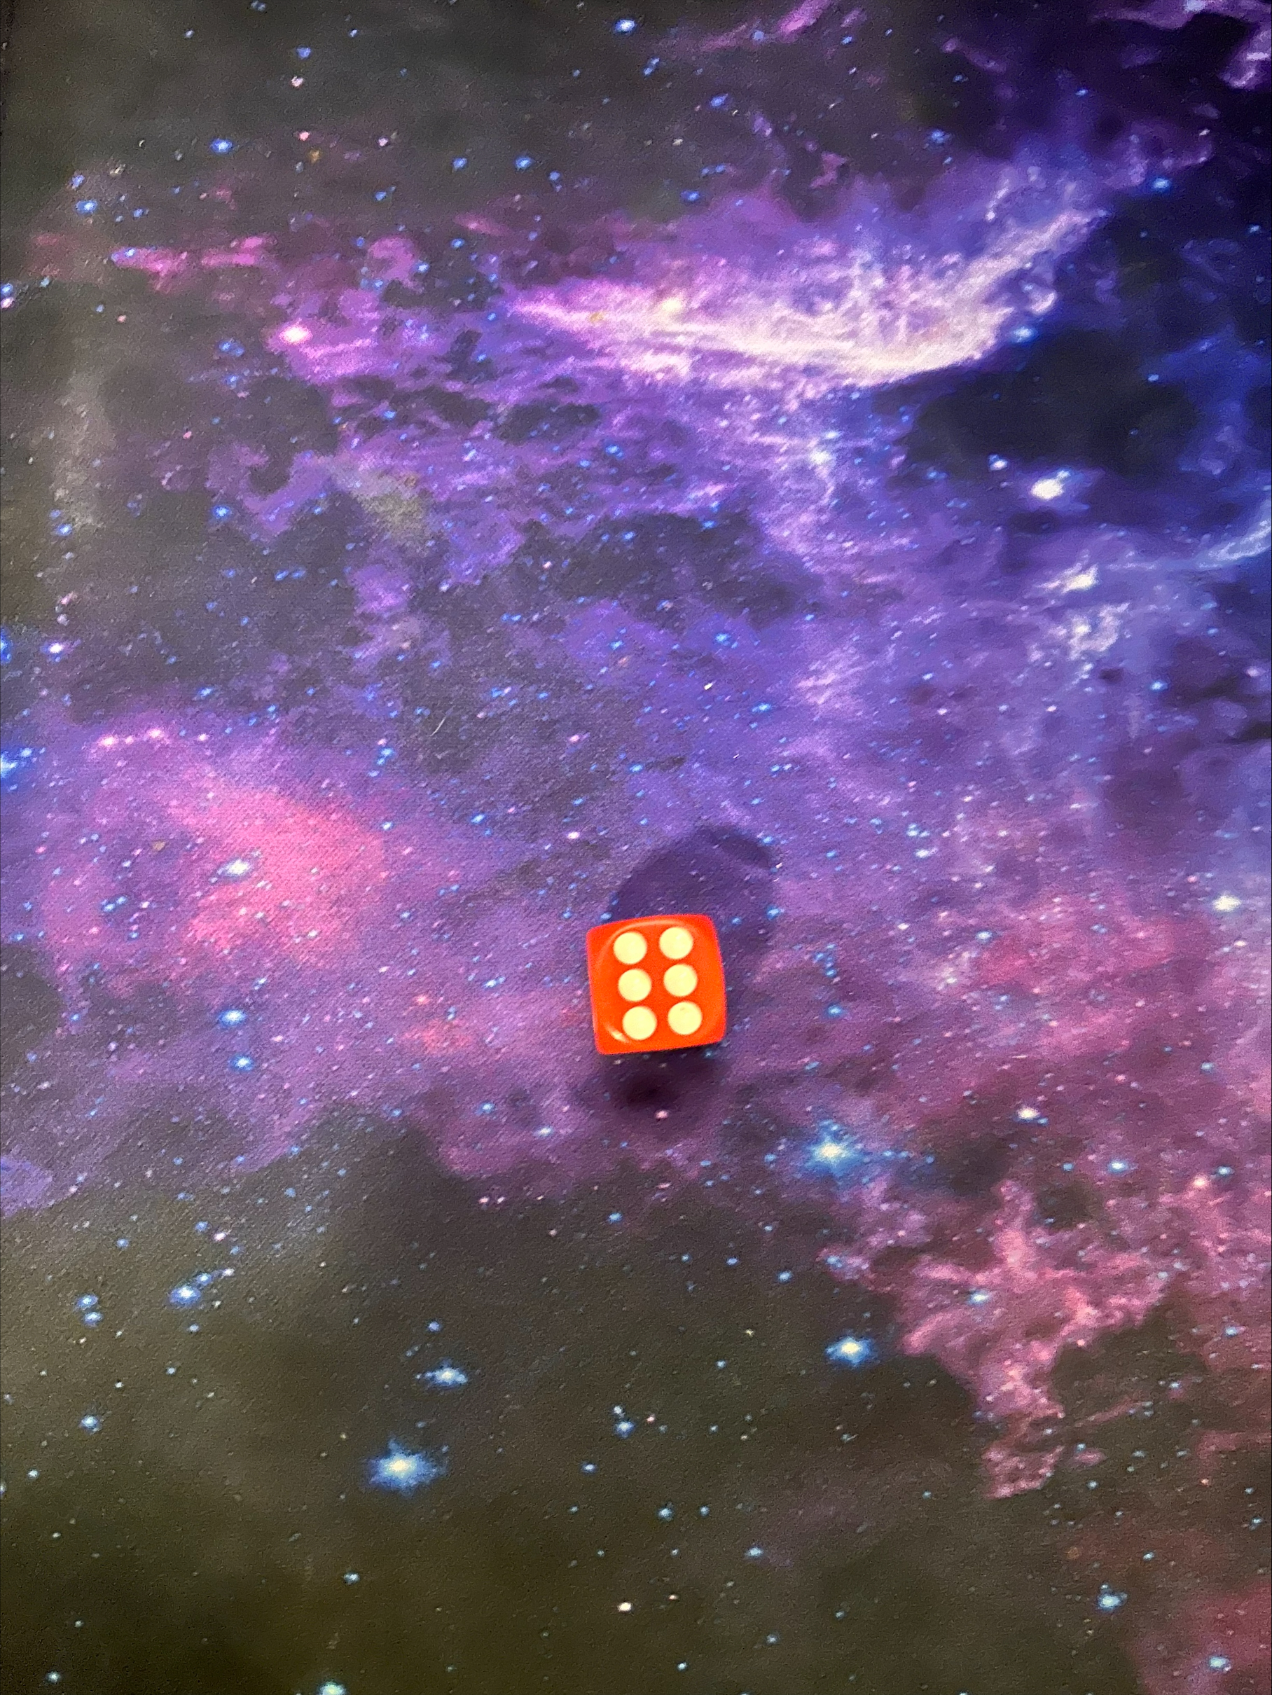
Physical Die Used (Normal 6-sided die)

Slide 9
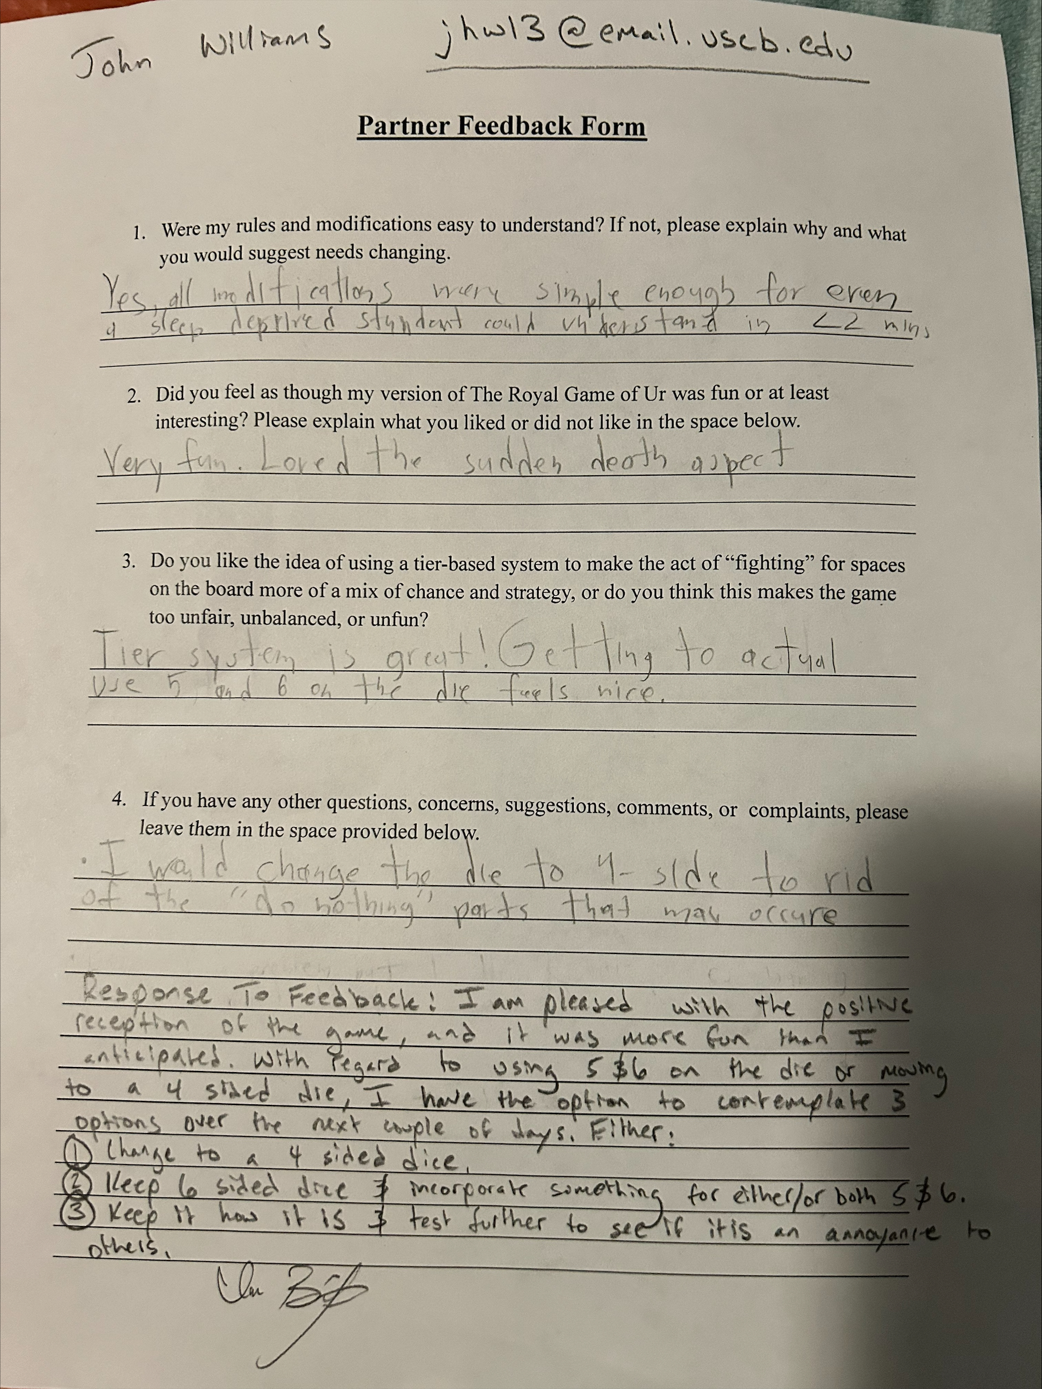
Original Feedback Received

Slide 10
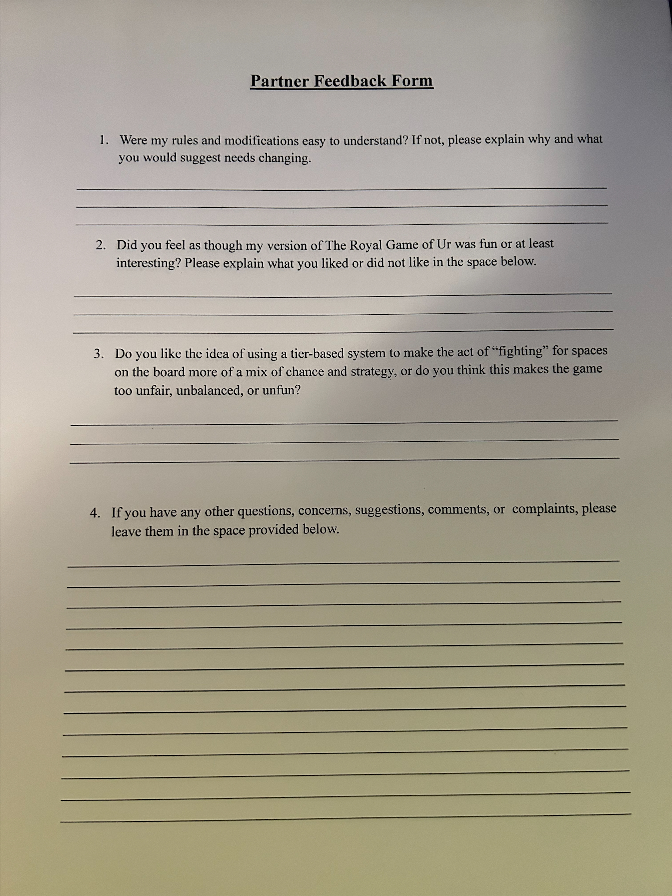
Physical Blank Feedback Form

